Slide 1
LIFESTYLE ASSESSMENT INFO MEETING

Slide 2
PERSONALIZED INSIGHTS FOR HEALTH AND PERFORMANCE
Professional Sports
More than 22 000 professional athletes and 800 teams worldwide use Firstbeat solutions to improve performance.
Consumer Products
Firstbeat’s heartbeat analytics are integrated into over 75 wearables to provide meaningful insights for fitness and lifestyle.
Wellness Services
250 000 people around the world have undergone the Firstbeat Lifestyle Assessment to improve their personal well-being & performance.

Slide 3
BODY ANALYTICS FOR SPORTS AND WELL-BEING
Established 2002 as a spin-off from Research Institute for Olympic Sports and University of Jyväskylä, Finland
Based on 20 years of research and experience in heartbeat and heart rate variability
Firstbeat has created a unique digital model of the physiology that turns heartbeat data into personal feedback
We bring near laboratory accuracy and technology used by professional athletes to everyone
MANAGE STRESS
ENHANCE RECOVERY
EXERCISE RIGHT

Slide 4
FIRSTBEAT LIFESTYLE ASSESSMENT
Helps you understand the state of your well-being and what to do to improve it.
Manage stress Recognize activities that cause stress
Enhance recovery See how you recover during sleep
Exercise right See the effect of your exercise
A comprehensive look at well-being during work, leisure and sleep!

Slide 5
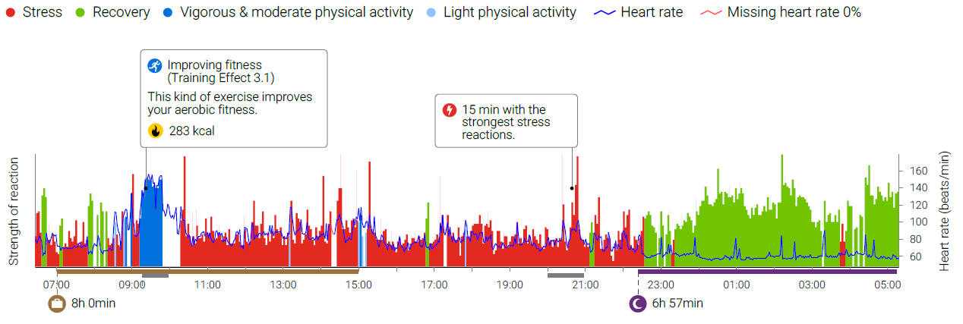
WHAT DOES YOUR DAY LOOK LIKE?
Are your stress and recovery in balance?
What are the health effects of your physical activity?
Is your sleep restorative?
Notes:
Case2016

Slide 6
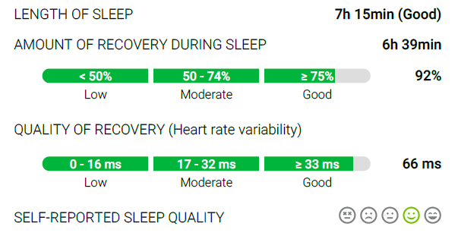
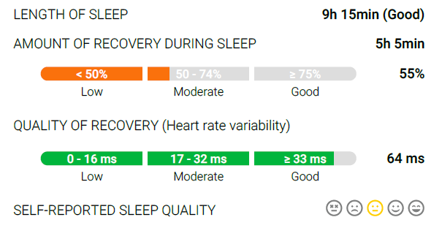
ALCOHOL WEAKENS RECOVERY
44-year-old healthy woman, BMI 21.3
Thursday
No alcohol, lowest heart rate 40
Friday
3 units of alcohol, lowest heart rate 43
Notes:
Case alcohol 2013

Slide 7
INTENSIVE EXERCISE CAN DELAY OPTIMAL NIGHTTIME RECOVERY
Notes:
Case busy mom

Slide 8
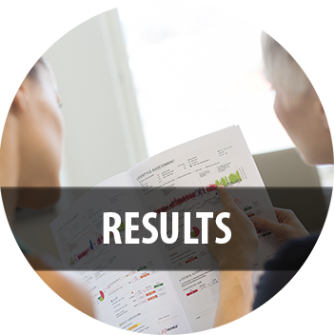
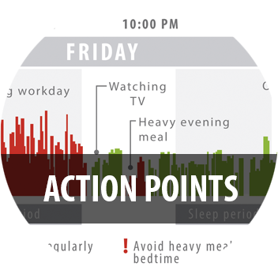
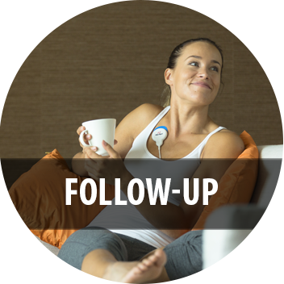
LIFESTYLE ASSESSMENT STEPS
1
2
3
4
HEARTBEAT MEASUREMENT
PERSONAL REPORT
FEEDBACK FROM A WELLNESS SPECIALIST
FOLLOW-UP
3 Days during work, sleep and leisure time
Additionally also an anonymous group report
Personal advise for improving well-being and performance
82% of users felt that they were able to improve stress management, exercise and/or quality of sleep.
93% of users:
”The measurement was easy to conduct”

Slide 9
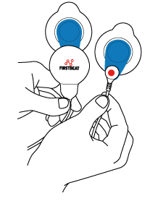
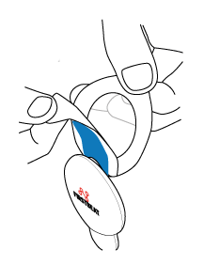
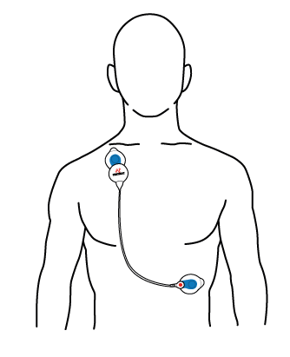
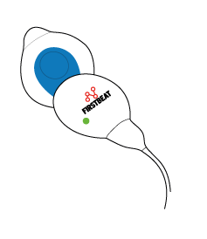
STARTING THE MEASUREMENT
Start the measurement within a week after receiving the device.
Start the measurement in the morning and end it 3 days later after you wake up.
View the instructional video here: www.Firstbeat.com/instructional-video
1. Attach the electrodes to the cable and device end.
2. Remove the cover.
3. Attach the device end to the right side of the body under the collarbone. The cable end is attached to the left side of the body on the rib cage.
4. The measurement starts automatically when the device is attached. Make sure the green led is flashing. Note: The light is easiest to see in a dark room.

Slide 10
DURING THE MEASUREMENT
When the green signal light is flashing the device is recording heartbeat data. If you see other lights or no lights, please contact your service provider.
Detach the device during showers, sauna and swimming. Recording continues automatically when you re-attach the device.
The electrodes are disposable. Change the electrodes at least once per day, e.g. after taking a shower or if they become loose.
The glue and electrode paste in the electrodes can irritate the skin; you can change the electrode locations on your skin slightly when putting on fresh electrodes.
End the measurement by detaching the device from your body. The measurement ends automatically.

Slide 11
Please note this about illnesses and other conditions
Lifestyle Assessment results can be unreliable and we do not recommend the measurement if the client has:
A pace maker
Heart transplant or a difficult heart condition
Chronic atrial fibrillation / atrial flutter
Uncontrolled thyroid dysfunction
High fever (it’s better to postpone the measurement if you have fever)
If you have one of the following conditions, you can make the measurement, but please note that the results can be difficult to interpret or unreliable:
Bundle branch block
Coronary heart disease with angioplasty or bypass surgery
Chronic neurologic disease (MS, Alzheimer, Parkinson)
Diagnosed severe depression or exhaustion (medicated)
Pregnancy
NOTE! Firstbeat Lifestyle Assessment is used to promote personal well-being, and is not designed for diagnosing illnesses.

Slide 12
REMEMBER!
Start the measurement within a week after receiving the device.
Attach the device and make sure the green led starts to flash.
End the measurement after 3 days.
Be sure to complete the personal information and journal fields.
Return the device to your contact person.

Slide 13
THANK YOU
www.firstbeat.com
#firstbeat
@FirstbeatInfo
Firstbeat Technologies
Firstbeat Technologies Ltd
@firstbeat_technologies

