Slide 1
INVITATION TO LIFESTYLE ASSESSMENT
Identify the factors affecting your wellbeing
Firstbeat Lifestyle Assessment provides personal insights on your wellbeing.
See how work, leisure and sleep affect your performance:
Manage stress
Enhance recovery
Exercise right
Lifestyle Assessment begins on: dd.mm.yyyy
Sign up: contact information
www.firstbeat.com
Notes:
INVITATION TO LIFESTYLE ASSESSMENT Recognize the factors affecting your well-being
Firstbeat Lifestyle Assessment gives you personal information about well-being. Find out how work, leisure and sleep affect your coping.
Manage stress
Enhance recovery
Exercise right
Lifestyle Assessment will be started: (dd.mm.yyyy)
Sign up for Lifestyle Assessment: (the persons contact infromation who invites to Lifestyle Assessment)

Slide 2
HOW TO CONDUCT LIFESTYLE ASSESSMENT TO YOUR PERSONNEL
To the presentation’s first slide, fill in the following information:
Date when the Lifestyle Assessment will be conducted
Your contact information
Save the first slide or the whole presentation in PDF format and share it via intranet, email or print out and put on a table in break room.
Receive sign ups from your staff members

Slide 3
FIRSTBEAT LIFESTYLE ASSESSMENT
Helps you understand the state of your well-being and what to do to improve it.
Manage stress Recognize activities that cause stress
Enhance recovery See how you recover during sleep
Exercise right See the effect of your exercise
A comprehensive look at well-being during work, leisure and sleep!

Slide 4
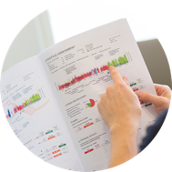
LIFESTYLE ASSESSMENT
1
2
3
4
MEASURE
LEARN FROM DATA
GET THE BALANCE RIGHT
MAKE LIFESTYLE CHANGES
Physiological snapshot of everyday life
Identify factors that affect your wellbeing and performance
Health coaching to improve wellbeing and performance
Improve stress management, exercise and sleep
quality

Slide 5
PERSONALIZED INSIGHTS FOR HEALTH AND PERFORMANCE
Professional Sports
More than 22 000 professional athletes and 800 teams worldwide use Firstbeat solutions to improve performance.
Consumer Products
Firstbeat’s heartbeat analytics are integrated into over 75 wearables to provide meaningful insights for fitness and lifestyle.
Wellness Services
250 000 people around the world have undergone the Firstbeat Lifestyle Assessment to improve their personal well-being & performance.

Slide 6
SATISFIED CUSTOMERS
”Firstbeat is a great tool that makes complex physiological variables visible and engages the client. It is a unique tool for understanding stress, recovery and resilience.”
–Oliver Patrick, Physiologist and Executive Director of Viavi
“The reports that we create with Firstbeat are very powerful visually. We are talking data and that is what our executive clients like. That is their language”
–Cristina Cooper, Assistant General Manager, Nuffield Health

Slide 7
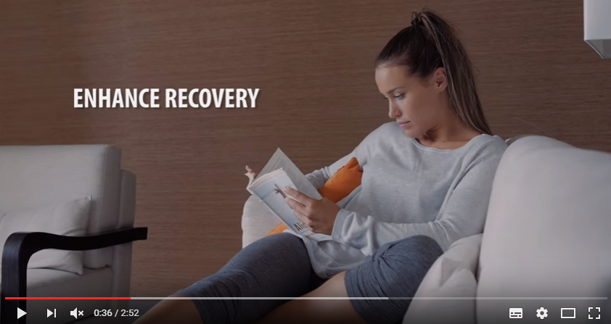
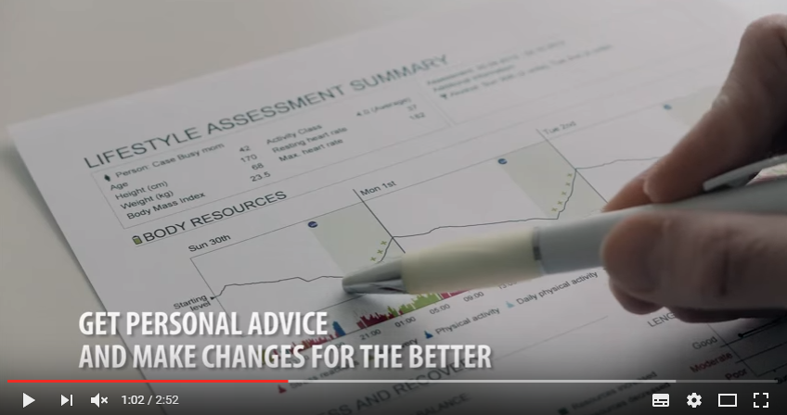
WATCH LIFESTYLE ASSESSMENT VIDEOS
Introduction to Lifestyle Assessment:
https://www.youtube.com/watch?v=6T7UWoEVfMo
Introduction to Firstbeat Lifestyle Assessment and Guidelines to Get Started:
https://www.youtube.com/watch?v=PRslWZHaYSA

Slide 8
Firstbeat Technologies Oy, Yliopistonkatu 28 A, 2nd Floor, FI-40100 Jyväskylä, Finland tel. +358 207631 660, info@firstbeat.com
www.firstbeat.com
#firstbeat
@FirstbeatInfo
Firstbeat Technologies
Firstbeat Technologies Ltd
@firstbeat_technologies

