Slide 1

Firstbeat
Lifestyle Assessment
Info Meeting
Name

Slide 2


AGENdA
01 Our Story
02 Firstbeat Lifestyle Assessment
03 Lifestyle Assessment in practice
04 Example reports and fitness level
05 Starting the measurement
06 During the measurement
07 Illnesses and other conditions

Slide 3
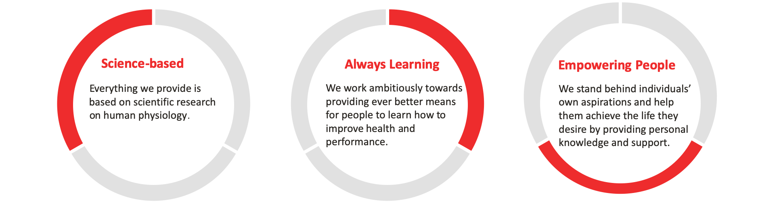
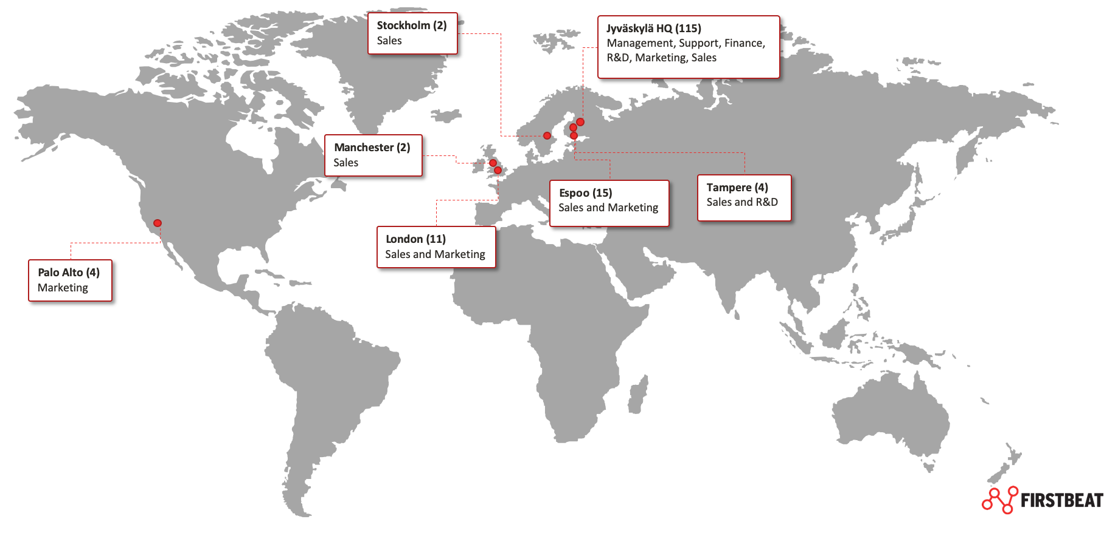
We are firstbeat
We help every individual reach their health and performance potential with science-backed confidence.
Founded in Jyväskylä in 2002
Firstbeat is a fast-growing technology company employing over 140 people in Finland, Sweden, UK, Germany, and US.
Customers in over 40 countries.
Our story began 20 years ago with a breakthrough in a Finnish sports-science lab, when our founders successfully modelled human physiology using heart rate variability (HRV) data and mathematics.

Slide 4
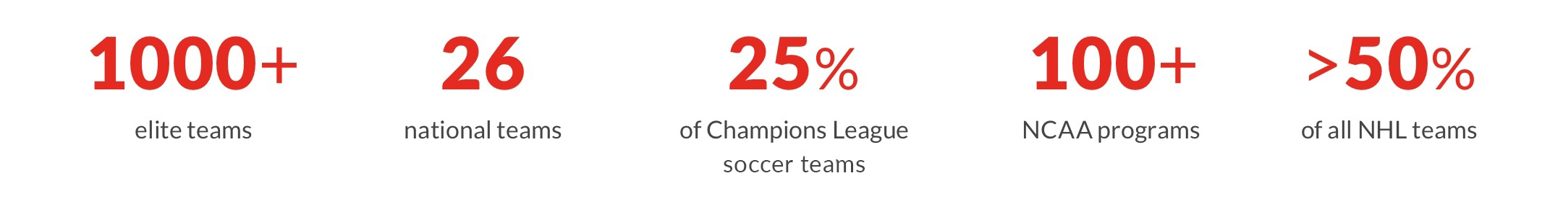














Trusted and used by millions of people
PROFESSIONAL SPORTS
CONSUMER PRODUCTS
WELLNESS SERVICES
More than 23 000 professional athletes and 1000 teams worldwide use Firstbeat solutions to improve performance.
Firstbeat’s advanced performance analytics are integrated into over 100 wearables to provide meaningful insights for fitness and lifestyle.
Firstbeat Lifestyle Assessment has been delivered to 300 000 employees for lifestyle health screening and coaching

Slide 5

Firstbeat Lifestyle Assessment
– reach your health and performance potential

Slide 6

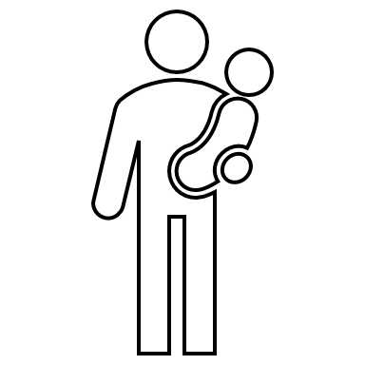




FROM HEART RATE VARIABILITY TO COMPREHENSIVE WELL-BEING
Various stressors in daily life cause physiological reactions that influence the body.
We can see these effects by measuring every heartbeat and the time between beats in milliseconds.
The variation in time between heartbeats is called heart rate variability (HRV).
Our unique method converts heartbeat data into an easily interpretable form: a personal report about the effects of stress, recovery and physical activity.
By recognizing the immediate effects of different stressors and choices, we can help you to make permanent changes that promote your well-being.

Slide 7
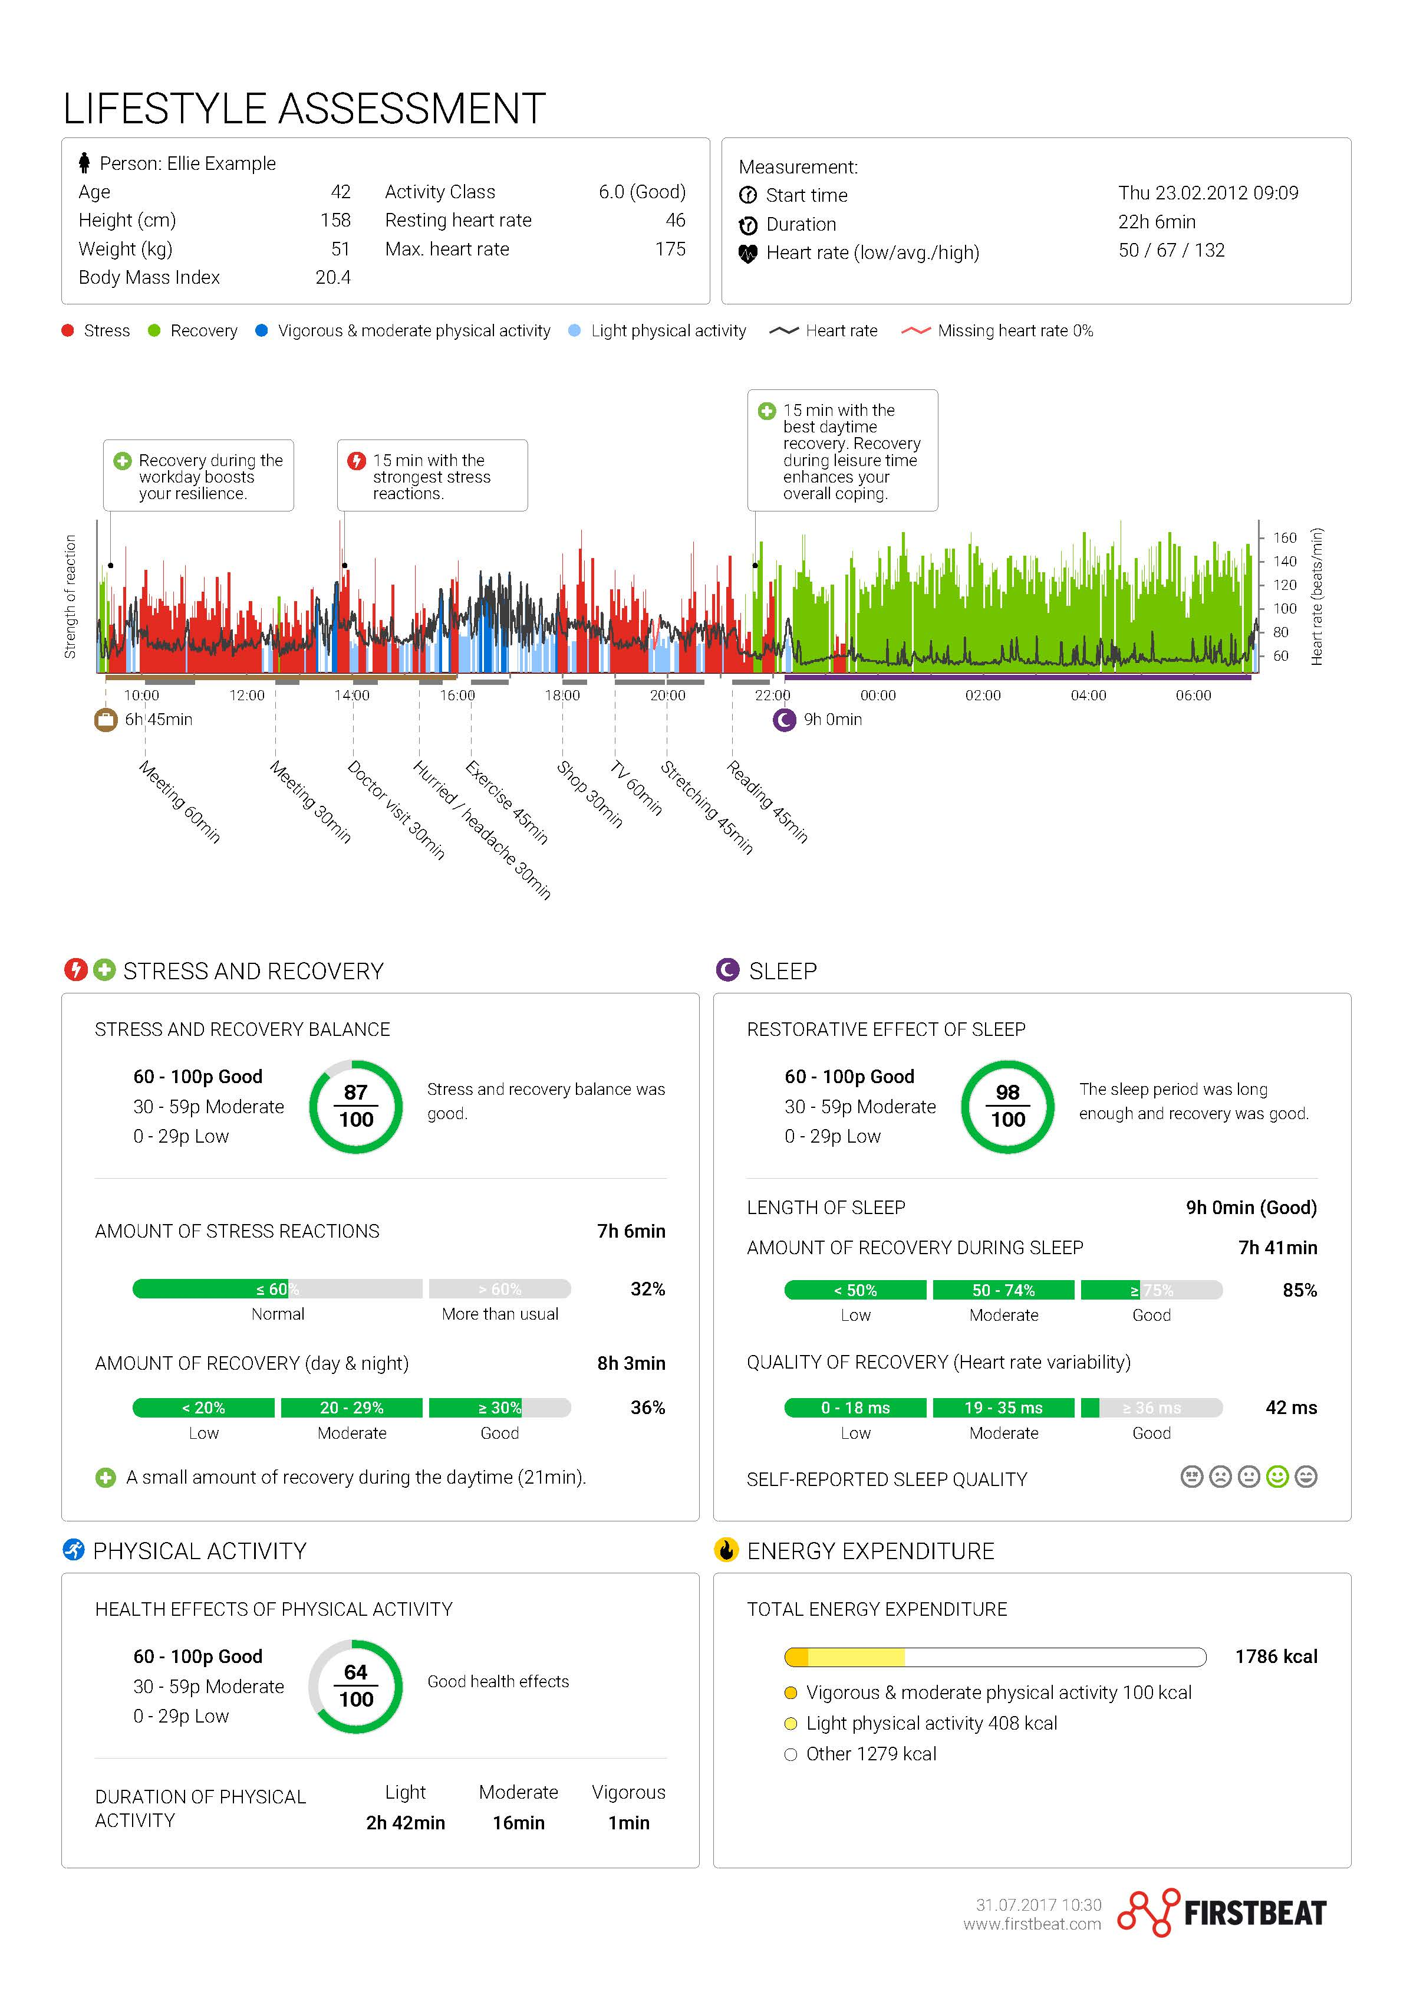

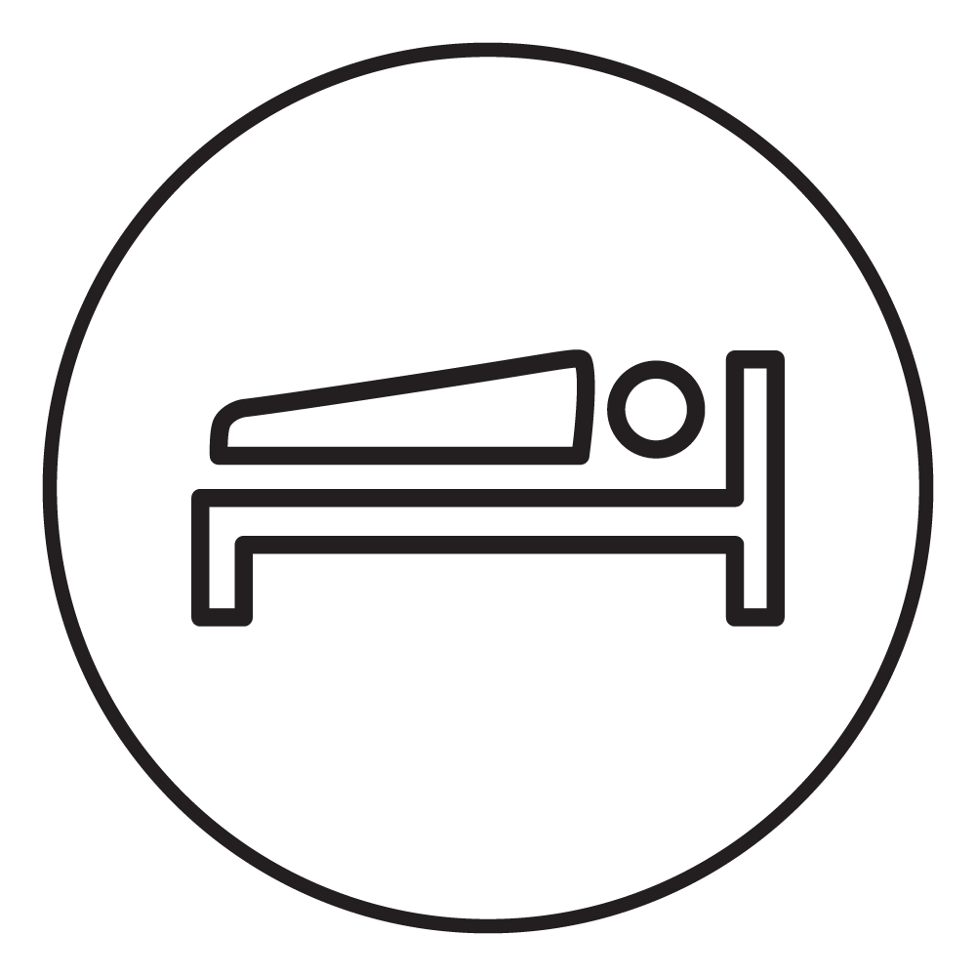
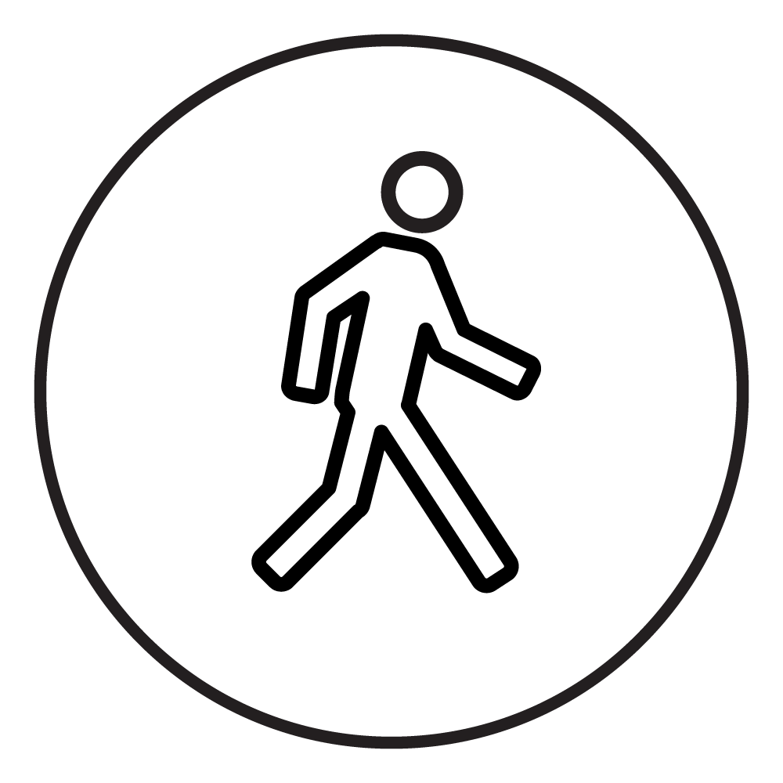
FIRSTBEAT LIFESTYLE ASSESSMENT
MANAGE STRESS
Recognize activities that cause stress
ENHANCE RECOVERY
See how you recover during day and night
EXERCISE RIGHT
Understand the effects of physical activity

Slide 8
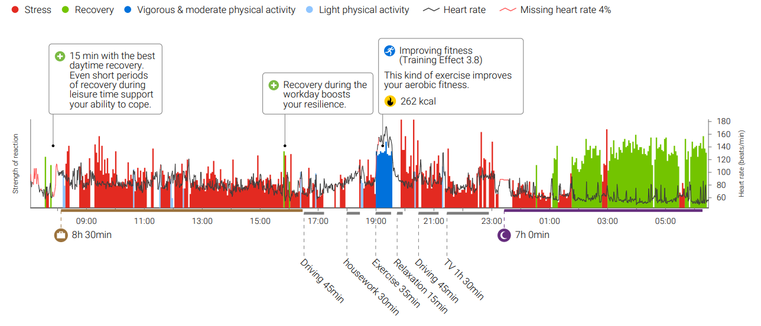
SEE YOUR DAYS IN A NEW LIGHT

Slide 9
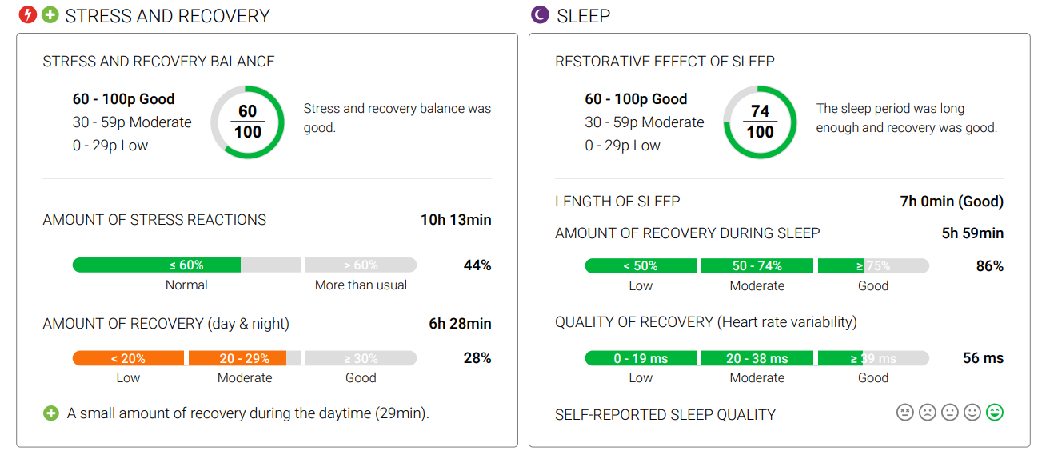
FOCUSED RESULTS FOR STRESS, RECOVERY, SLEEP & EXERCISE

Slide 10
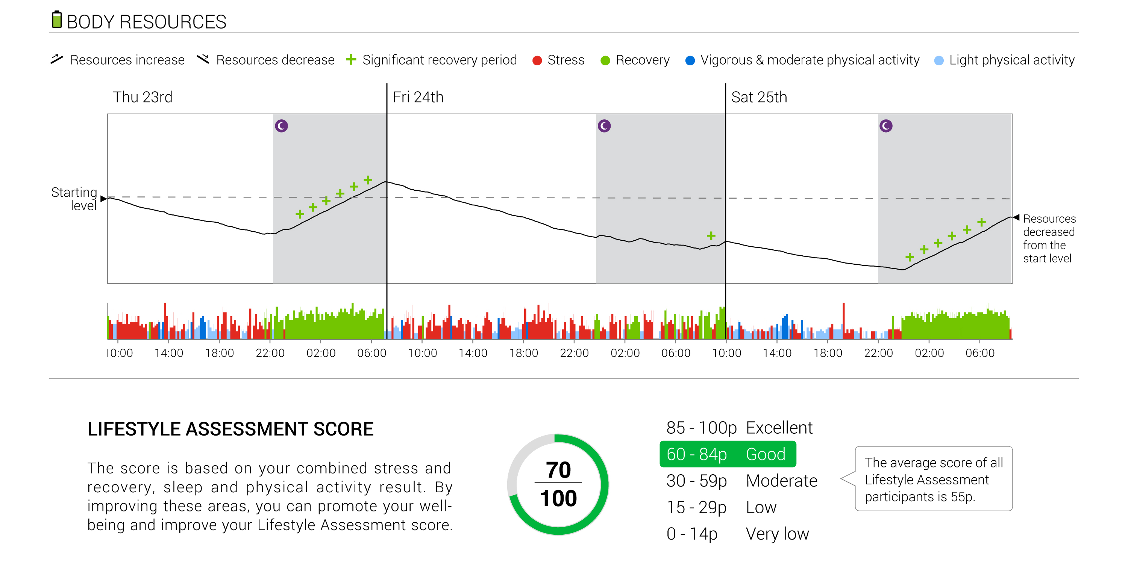
Are you building OR CONSUMING your body’s resources?

Slide 11
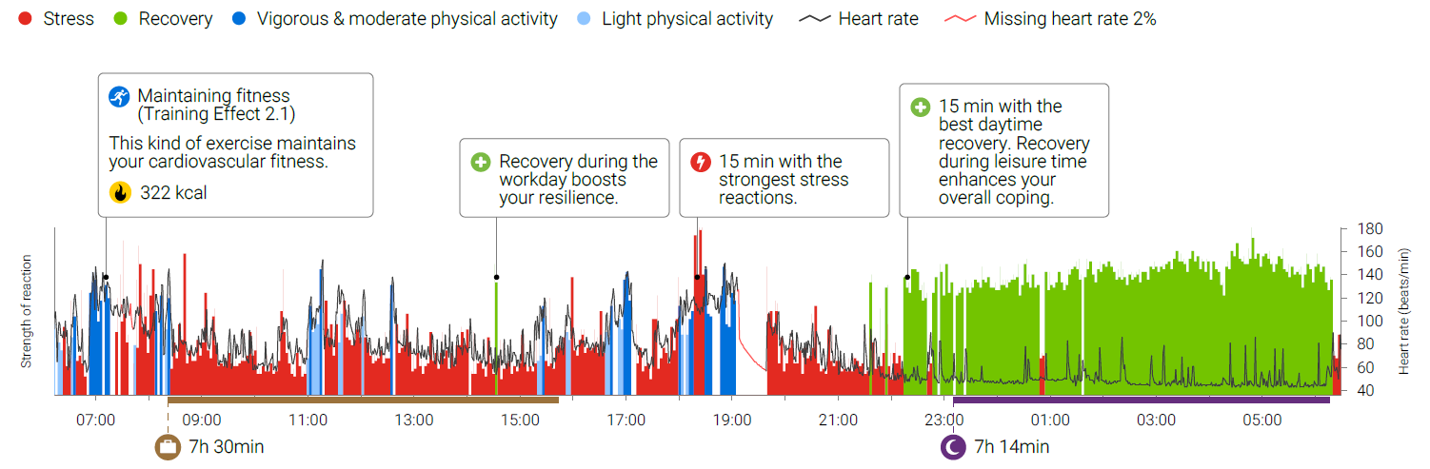
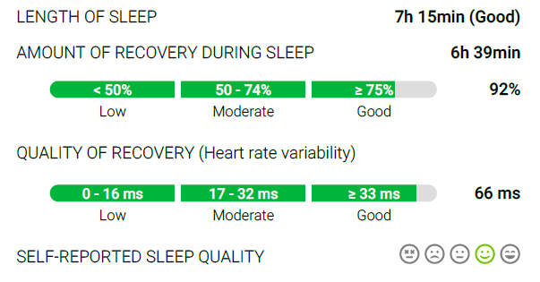
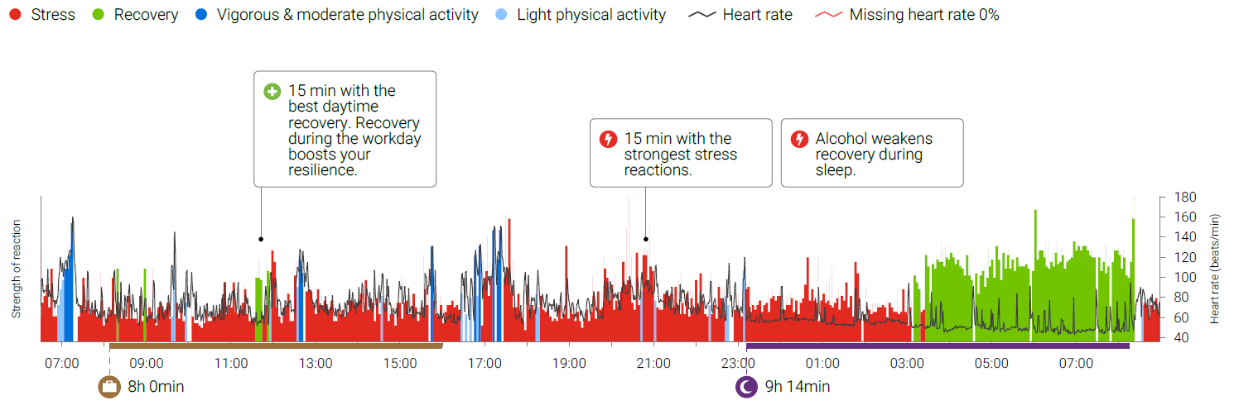
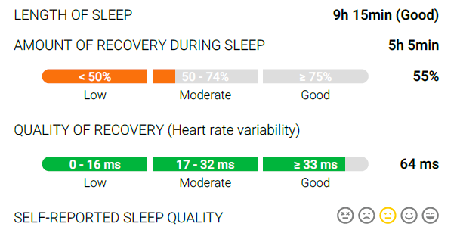
EXAMPLE: Alcohol weakens recovery
44-year-old woman
Thursday
No alcohol, lowest heart rate 40
Friday
3 units of alcohol, lowest heart rate 43

Slide 12
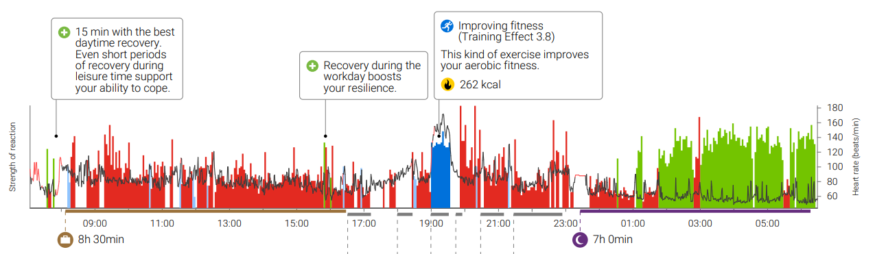

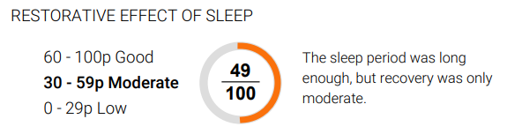
EXAMPLE: ACUTE EFFECT OF IntensIVE exercise ON SLEEP

Slide 13

DO YOU WANT TO KNOW YOUR FITNESS LEVEL?
Lifestyle Assessment’s Fitness level can estimate your maximal oxygen uptake (VO2max) or aerobic fitness.​
Walk at least 30 minutes continuously at moderate – brisk pace any time during your 3-day assessment.
For an accurate result, walk on flat terrain or on a treadmill. Avoid heavy loads, talking and stopping. Do not run or Nordic walk.
  Steady pace - your result will not improve if you try to go as fast as possible.
  Mark your Fitness Level walk in your journal.
We do not recommend the fitness level walk if you have a condition that limits your ability to walk, Beta-blocker medication or if you are not used to any exercise.
You can complete the Lifestyle Assessment without Fitness Level estimation!

Slide 14




Lifestyle assessment steps
1
2
3
4
HEARTBEAT MEASUREMENT
PERSONAL REPORT
FEEDBACK FROM A WELLNESS SPECIALIST
CHANGE FOR THE BETTER
3 Days during work, sleep and leisure time. Filling the journey completes the measurement.
See the factors that affect your well-being in your personal report. Your employer will not see your result.
Personal advise for improving
well-being and performance.
Meaningful, focused goals motivate you to make permanent lifestyle changes.

Slide 15
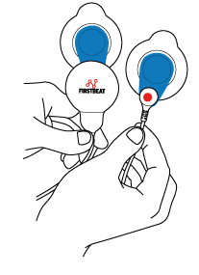
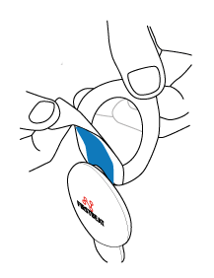
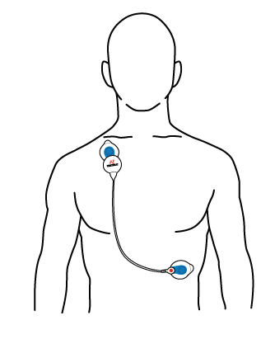
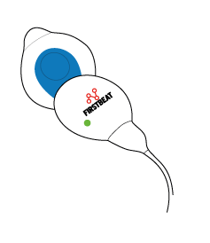
STARTING THE MEASUREMENT
You will get an email from Lifestyle Assessment / service@firstbeat.fi with a link for ordering your device and for filling in your personal information and the journal. Please check your spam folder if you don’t see the email
Start the measurement within a week after receiving the device.
The measurement lasts 3 days. Start the measurement in the morning and end it 3 days later after you wake up.
You will receive a link to a short instructional video via email: https://youtu.be/pg1oxMb4z10
1. Attach the electrodes to the cable and device end.
2. Remove the cover.
3. Attach the device end to the right side of the body under the collarbone. The cable end is attached to the left side of the body on the rib cage.
4. The measurement starts automatically when the device is attached. Make sure the green led is flashing. Note: The light is easiest to see in a dark room.

Slide 16

During the measurement
Live as you normally would – the idea is to see your real life.
Fill the journal on a laptop or mobile phone’s web browser
Change the electrodes at least once per day, e.g. after taking a shower or if they become loose.
The device is not water proof, so detach it during showers, sauna and swimming. Recording continues automatically when you re-attach the device.
The electrodes can irritate your skin. You can change their location on your skin slightly when changing them.
End the measurement by detaching the device from your body. Also complete your journal then.
Return the device in the provided, postage-paid package.
Book a personal feedback appointment (30 mins via phone).
  You will get an email invitation from Firstbeat (service@firstbeat.fi) to do this when your report is ready.
In problem situations, please contact support@firstbeat.com

Slide 17
Please note this about illnesses and other conditions
Lifestyle Assessment results can be unreliable and we do not recommend the measurement if the client has:
  High fever (it’s better to postpone the measurement if you have fever)
  A pace maker
  Heart transplant or a difficult heart condition
  Chronic atrial fibrillation / atrial flutter
  Uncontrolled thyroid dysfunction
If you have one of the following conditions, you can make the measurement, but please note that the results can be unreliable:
  Bundle branch block
  Coronary heart disease with angioplasty or bypass surgery
  Chronic neurologic disease (MS, Alzheimer, Parkinson)
  Diagnosed severe depression or exhaustion (medicated)
  Pregnancy
NOTE! Firstbeat Lifestyle Assessment is used to promote personal well-being, and is not designed for diagnosing illnesses.
Notes:
Ylempi osio: tärkeää painottaa, missä tilanteissa emme suosittele tekemään mittausta.
Alempi osio: näissä tapauksissa mittaus voidaan tehdä, mutta mitattavan on hyvä tietää ennakkoon, että mittaustulokset voivat olla epäluotettavia.

Slide 18
We’re all individuals, and what works for some, might not work for everyone. The answer has to come from within.
With the right science backing you up, you can make confident choices to help you reach your health and performance potential.
You have it in you.

Slide 19
Thank you!

